Slide 1
VIRTUAL SCREENING OF PHYTOCHEMICALS TO HIGHLIGHT THE HIT MOLECULES FOR SKIN LIGHTENING FORMULATIONS
Submitted by- Meghant Prasad Chowdhary CLASS ROLL NO: 002130201004 EXAMINATION ROLL NO: M4BMD23006 Under the guidance of Dr. Piyali Basak Associate Professor School of Bioscience and Engineering Jadavpur University Kolkata-700032
School of Bioscience and Engineering Faculty of Engineering and Technology Jadavpur University Kolkata-700032

Slide 2
• Table of contents
03
01
02
04
-Phytochemical Database Selection
-ADMET properties
-Selection of Protein Targets
-Protocol for Molecular Docking
-Preparation of Ligand
-Preparation of Protein
-Grid Generation
-Scoring and Docking Simulation
-Evaluation and Analysis
Introduction
-Research Objective
Methodology
-Mechanism of skin pigmentation
-Molecular docking
-Techniques for Molecular Docking
-Benefits of Molecular Docking in Research on Skin Lightening
-Mechanism of docking with its importance
-Different types of docking
Literature Review
-Analysis of Screening and Binding Affinity
-Analysis of Molecular Interactions
Results & Analysis
05 Conclusion

Slide 3
Introduction
Skin is a flexible, protective organ covering our bodies.
Three Layers: It comprises three primary layers: epidermis, dermis, and hypodermis.
Melanocytes:These cells in the basal layer produce melanin, essential for skin color and protection from UV radiation.
Melanin Transport: Dendrites transport melanin from melanocytes to nearby keratinocytes, forming the epidermal melanin unit.
2. We aim to discover natural compounds that can lighten skin using computer-based methods, specifically molecular docking.
Our goal is to find molecules that can change certain proteins responsible for melanin production, which is how skin gets its color.
3.Identifying the hit molecules and analyzing
molecular mechanism.

Slide 4
• ResearchObjectives •
-The following research questions are addressed in the thesis:
1.Can molecular docking accurately anticipate the interactions and binding affinities between phytochemicals and target proteins involved in controlling skin pigmentation?
2.Which phytochemicals have the most binding affinity and have the greatest potential as skin lightening treatments?
3.What are the main molecular interactions and processes through which these phytochemicals influence the pathways leading to melanogenesis?
Some research articles were taken from google scholar, crossref, and pubmed. Finally some articles were selected from it in order plan this research.

Slide 5
• LITERATURE REVIEW•
Mechanisms of Skin Pigmentation
-Melanin is the pigment that decides our skin color. It's produced, moved around, and distributed as part of a process called skin pigmentation.
-Various proteins and enzymes, like tyrosinase,control the creation of melanin,known as melanogenesis.
The reason behind selection of elastase, tyrosinase, and collagenase as the three protein is as follows-
1.ELASTASE- Responsible for breakdown of elastin(a protein in the skin that helps to maintain skin elasticity and firmness).
2.TYROSINASE- It is the key enzyme involved in melanin production
-responsible for skin pigmentation
-responsible for skin tone colour
3.COLLAGENASE- Collagenase is an enzyme that breaks down collagen(a crucial protein for maintaining skin structure and reducing the appearance of wrinkles) .

Slide 6
• Molecular Docking•
-Imagine you have a key (the molecule) and a lock (the protein). You want to know if the key can fit into the lock and how well it fits. Molecular docking helps you figure that out.
Basics steps of docking:
STEP1: Getting the complex PDB.
STEP2: Cleaning the complex.
STEP3: Adding the missing hydrogels/side chain atoms and minimize the complex.
STEP4: Preparing the docking suitable files.
STEP5: Cleaning of the minimized complex.
STEP6: Preparing all the required files for docking.
STEP7: Run the docking.
STEP8: Analyze the results of docking.

Slide 7
•Techniques for Molecular Docking•
Know the Shapes: We need to know the 3D shapes of the molecules.
Score the Fit: Each time they try, a computer gives a score. A high score means the molecules fit together well.
Find the Best Match: They keep trying until they find the best match, where the molecules fit together the best.
Notes:
1.It is a mathematical model that calculates a score for each ligand.
2. LOW SCORE GENERALLY INDICATES BETTER BINDING AFFINITY OR STRONGER INTERACTION.

Slide 8
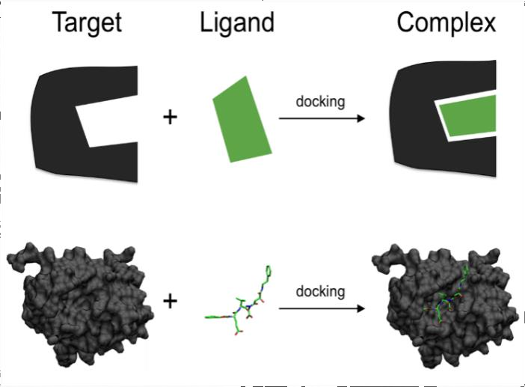
•Benefits of Molecular Docking in Research on Skin Lightening•
Efficient Screening: Quickly identifies potential skin-lightening compounds.
Precise Binding Prediction: Predicts how well a molecule will attach to skin proteins, aiding effective product design.
Safety Assessment: Evaluates interactions to ensure product safety, reducing side effects.
Customization: Tailors compounds for specific skin targets, enhancing effectiveness.
Reduced Animal Testing: Minimizes the need for animal experiments by providing insights into molecule-protein interactions.
Cost-Effective: Saves money by guiding research toward promising compounds, reducing trial-and-error.

Slide 9
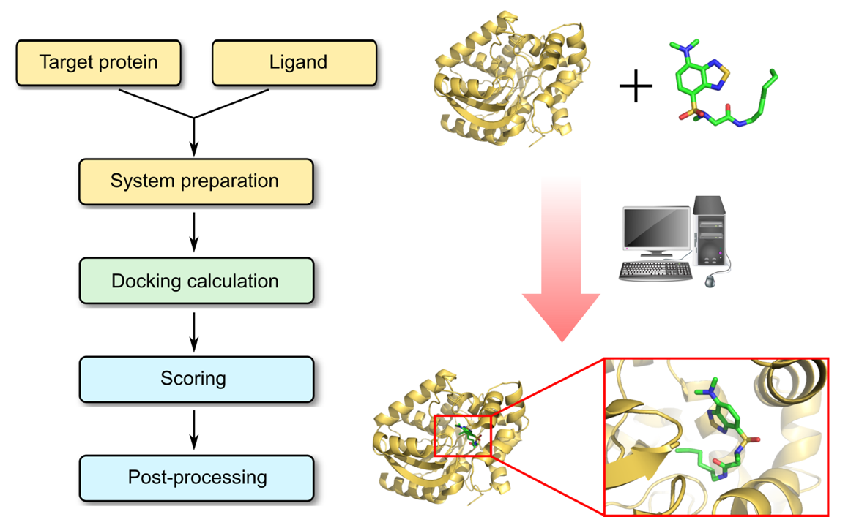
• Mechanism of docking with its importance•
Purpose: Molecular docking helps model how small chemicals (ligands) interact with proteins at an atomic level.
-Binding Affinity: amount of energy required to separate a particle from a system of particles or to disperse all the particles of the system.
Importance of Knowing Binding Site: Knowing the binding site's position before docking greatly improves the accuracy of the process.
Notes:
-Binding energy refers to the amount of energy that holds the particles inside an atom's nucleus together.

Slide 10
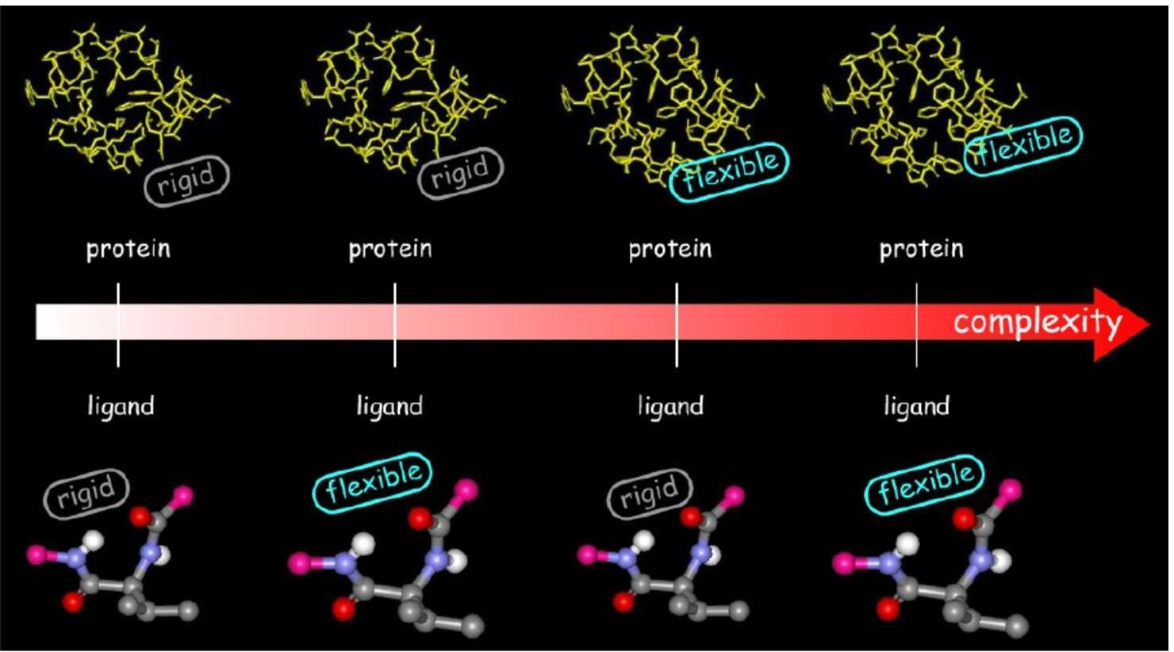
• Types of Docking•
Rigid Docking: The shapes stay the same, and you see if they fit.
Flexible Docking:Flexible docking allows molecules to change their shapes a bit to find the best fit with proteins.
Rigid docking is simpler, while flexible docking considers how molecules can adapt for a better fit, making it more realistic for certain situations in molecular research.
Notes:
Flexible: Molecules are allowd to change their shape,consider rotatable bonds
Rigid : Not allowed,does not consider

Slide 11
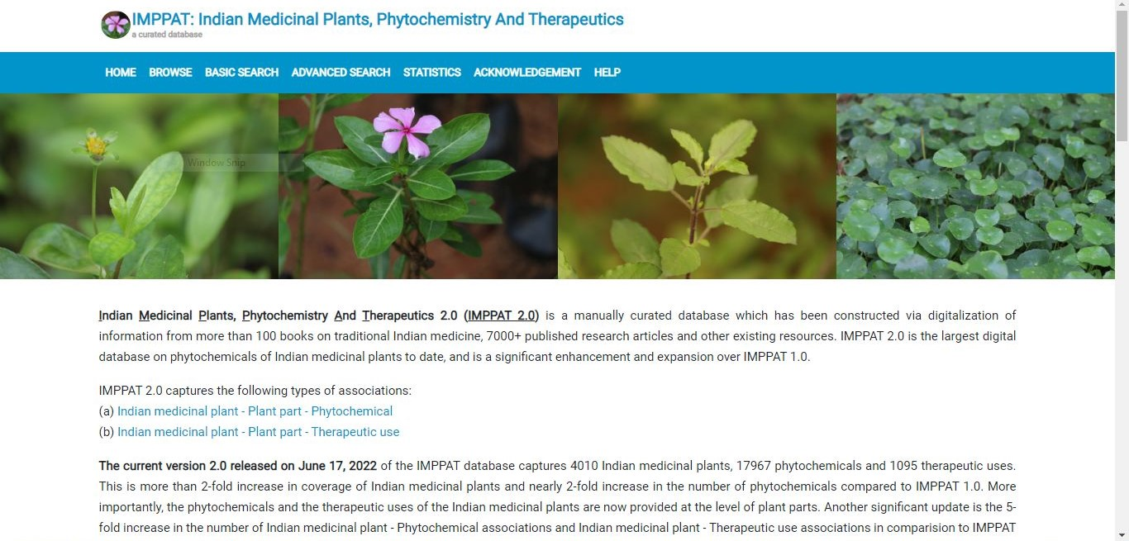
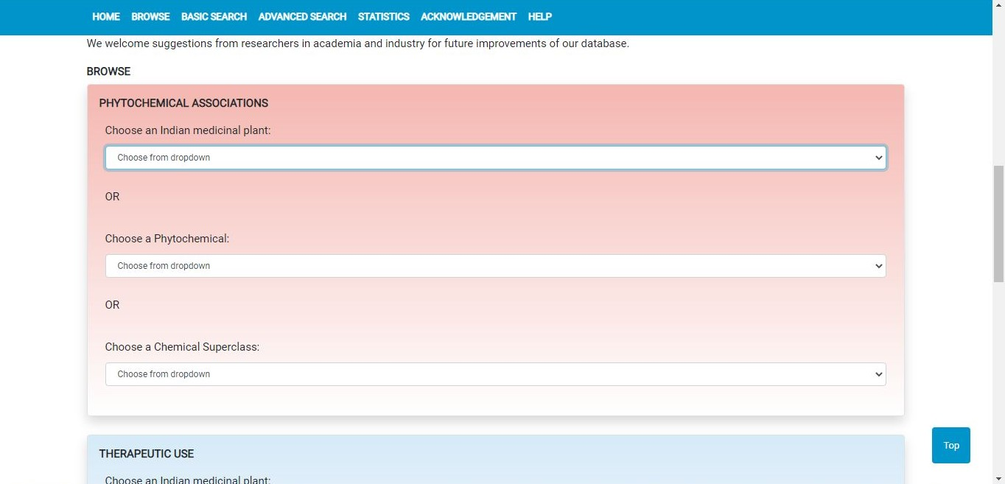
•Methodology•
Phytochemical Database Selection
-Database Importance: To screen skin-lightening compounds effectively, a diverse and comprehensive phytochemical database is essential.
-Selection Criteria: Compounds in the database should have proven skin-lightening effects and available structural data.
-Data Sources: Valuable sources for gathering these molecules include well-known databases like PubChem, ChemSpider, and specialized phytochemical databases.

Slide 12
• ADME properties•
Tool: We accessed Swiss ADME, a software from the Swiss Institute of Bioinformatics, using this link: www.swissadme.ch
Estimation: Swiss ADME was used to estimate how individual phytoconstituents behave in terms of
Absorption, Distribution, Metabolism, and excretion (ADME).
Results: The analysis results for each molecule were presented in tables and Excel spreadsheets.

Slide 13
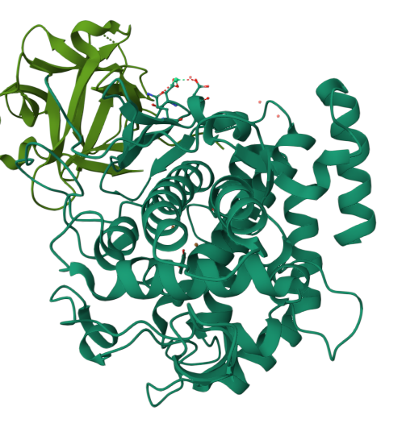
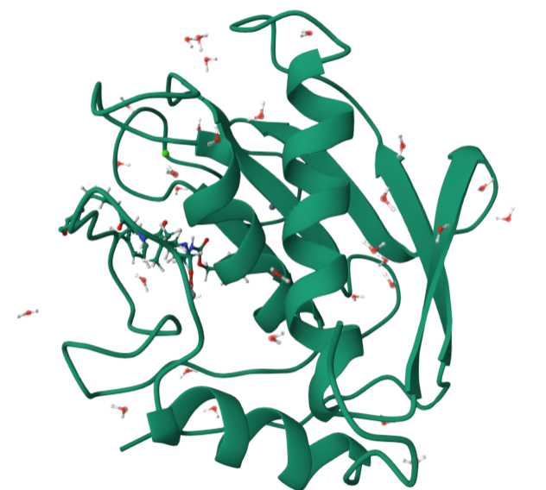
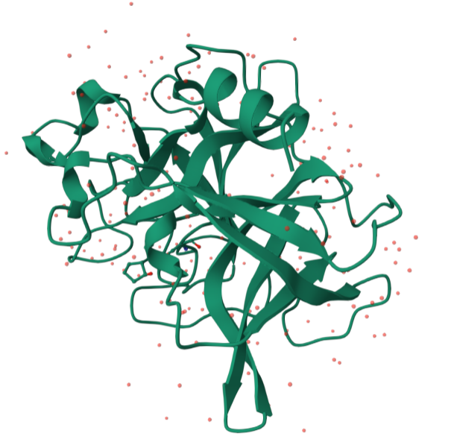
•Selection of Protein target•
-To screen for skin-lightening compounds, we need to target proteins that control melanin production.
Chosen Proteins: In our research, we focused on three important proteins related to skin pigmentation and health:
Tyrosinase (PDB CID: 2Y9X)
Collagenase (PDB CID: 1CGL)
Elastase (PDB CID: 1BRU)
These proteins are crucial for understanding and regulating skin pigmentation, making them ideal targets for our study.

Slide 14
• Protocol for Molecular Docking•
-Get Complex: Obtain the protein-ligand complex structure.
-Clean and Complete: Remove unnecessary parts, add missing atoms, and make it stable.
-Prepare for Docking: Format files and set up parameters.
-Run Docking: Start the docking simulation.
-Analyze Results: Study the outcomes of the docking process.

Slide 15
• Preparation of Ligand
Ligand Creation: Phytochemicals from the database are transformed into ligands for docking.
Tasks: This involves adding hydrogen atoms, optimizing molecular shape, and applying correct charges.
Tools: Software like Open Babel or DISCOVERY STUDIO is used for these preparations.
Get Protein Structure: Obtain the protein structure, often from the Protein Data Bank.
-Prepare the protein by
-removing water
-adding hydrogen atoms
-assigning charges
-optimizing its structure.
Tools: Use software tools like AutoDock Tools for these preparations.
• Preparation of Protein

Slide 16
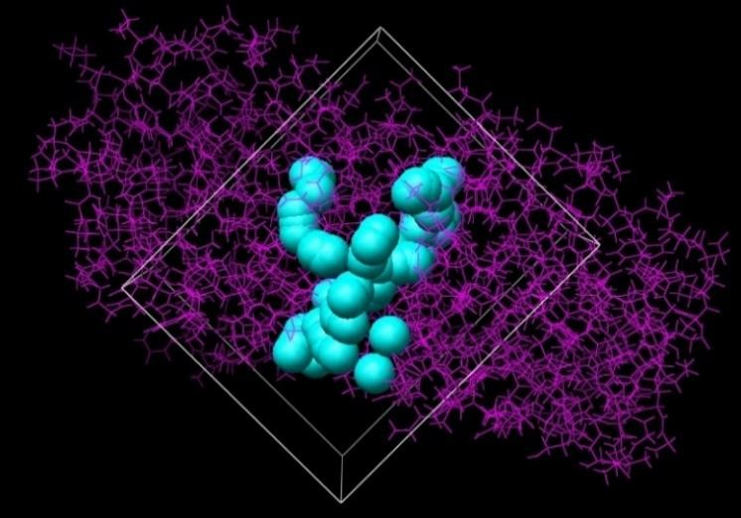
• Grid Generation •
Creating a Docking Grid:
Why?: Make a grid around the protein to show where molecules can attach.
Where?: Put the grid over the specific spots where molecules are supposed to stick.
Efficiency: Choose the grid size and spacing carefully to balance thoroughness and speed.

Slide 17
• Scoring and Docking Simulation•
-Setting Up: We place ligands inside our docking grid.
-Finding the Best Fit: The program explores different ligand positions and shapes to see which one fits best.
-Ranking: Algorithms decide which ligands are likely to bind strongly and rank them accordingly.
-More Runs: To consider ligand flexibility, we run the process multiple times (9 runs) for better results.

Slide 18
• Evaluation and Analysis•
-Review Results: We look at the outcomes of the docking simulations.
-Top Ligands: Identify the best-ranked ligands that might work for skin lightening.
-Molecular Insights: Study how these ligands interact with proteins, focusing on key parts and binding patterns.

Slide 19
•RESULTS AND ANALYSIS•
-Analysis of ADMET properties
Screening Process: We tested 37 phytochemicals, but they didn't meet the criteria for drug-like molecules, so we excluded them.
Rule of Five: The phytochemicals that passed Lipinski's Rule of Five were chosen as our potential ligands for further study.
(i.e. containing 175 compounds).

Slide 20
•Analysis of binding affinity and molecular interaction•
Phytochemicals exhibiting strong interaction with all the chosen 3 receptors
Compound | Binding affinity (in kcal/mol)
 | Tyrosinase | Elastase | Collagenase
1.beta-Copaene | -10 | -9.1 | -8.6
2.Kaempferol-7-rhamnoside | -10.1 | -8.8 | -10.6
3.Abiesin | -10.2 | -8.7 | -11.5
4.Flavanomarein | -9.2 | -8.2 | -10.1
5.Quercitrin | -8.5 | -8.2 | -9.5
6.Taraxerol | -10.9 | -8 | -10.8
7.Friedelin | -9 | -8 | -8.6
8.Hesperidin (standard skin- lightening agent) | -9.9 | -8.4 | -11.2

Slide 21
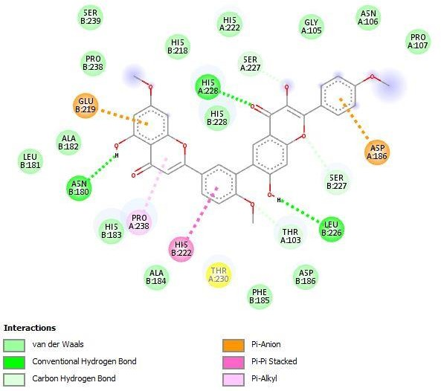
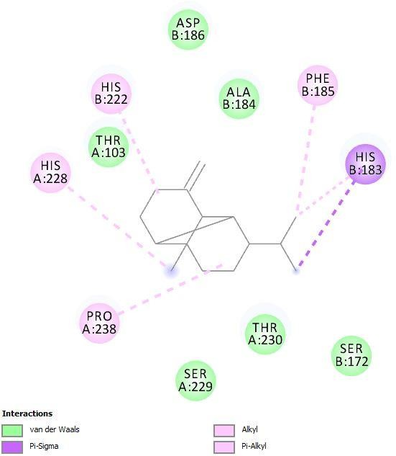
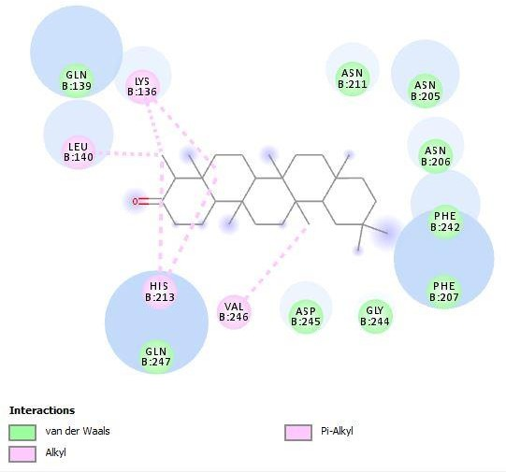
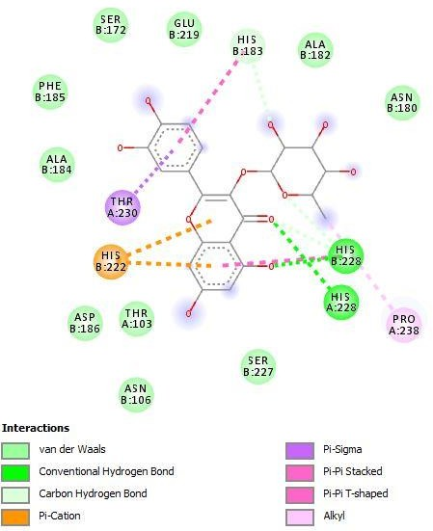
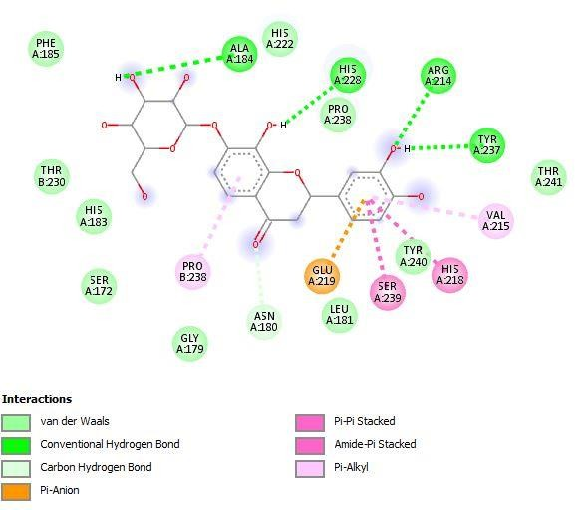
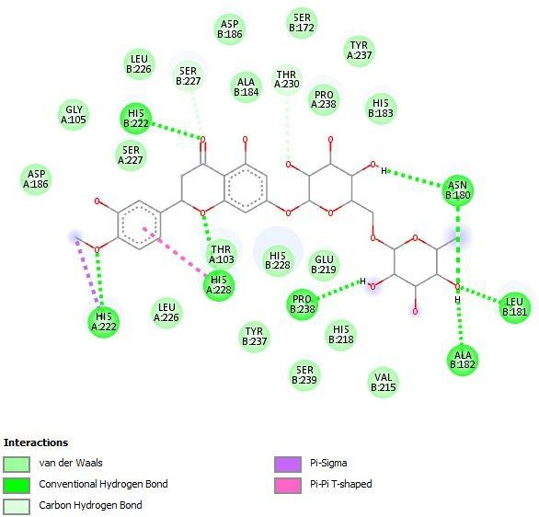
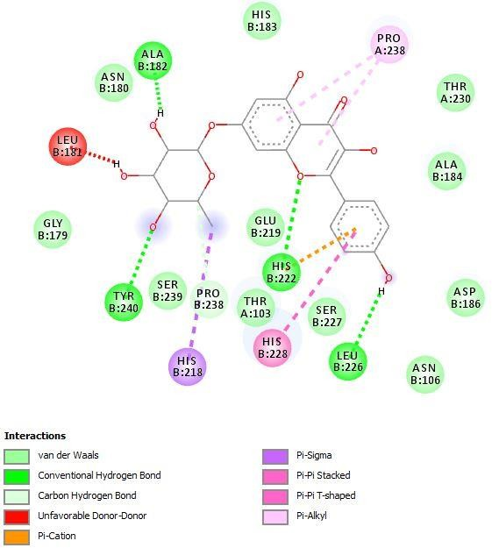
• •
2D interaction diagram showing the interacting residues of the hit molecules with the receptor collagenase: (a) abiesin, b) beta-Copaene (c) friedelin (d) flavanomarein (e) Hesperidin (f) kaempferol-7-rhamnoside (g) quercitrin
(h) taraxerol
Notes:
All the 7 compounds show same interacting residues w.r.t hesperidin
And also have same binding pocket which shows same mechanism of action on the receptor.

Slide 22
•Analysis of binding affinity and molecular interactions•
-Analyzed how top ligands interact with target proteins.
Studying various interactions like hydrogen bonds, hydrophobic contacts, electrostatic interactions.
-Finding binding motifs and key residues in these interactions.
-This helps us grasp how ligands influence proteins, potentially stopping melanin production for skin lightening.

Slide 23
• Conclusions
-In molecular biology and drug discovery, precise ligand-receptor binding predictions are crucial. Molecular docking, a computational method, is key to this. This thesis aims to enhance docking algorithms and explore applications.
-Commercial skin whitening products target conditions like Melasma and Post-inflammatory hyperpigmentation by regulating melanin production via tyrosinase inhibition.
-Our study investigates natural skin lightening agents and identifies potential phytochemicals as multi-targeted inhibitors of tyrosinase, collagenase, and elastase, reducing skin pigmentation.

Slide 24
• Acknowledgment
-In molecular biology and drug discovery, precise ligand-receptor binding predictions are crucial. Molecular docking, a computational method, is key to this. This thesis aims to enhance docking algorithms and explore applications.
-Commercial skin whitening products target conditions like Melasma and Post-inflammatory hyperpigmentation by regulating melanin production via tyrosinase inhibition.
-Our study investigates natural skin lightening agents and identifies potential phytochemicals as multi-targeted inhibitors of tyrosinase, collagenase, and elastase, reducing skin pigmentation.

Slide 25
• Research References
Chuong, C.M., Nickoloff, B.J., Elias, P.M., Goldsmith, L.A., Macher, E., Maderson, P.A., Sundberg, J.P., Tagami, H., Plonka, P.M., Thestrup-Pederson, K. and Bernard, B.A., 2002.
What is the'true'function of skin?. Experimental dermatology, 11(2), pp.159-187.
Feng, X., Li, G.Y., Ramier, A., Eltony, A.M. and Yun, S.H., 2022. In vivo stiffness measurement of epidermis, dermis, and hypodermis using broadband Rayleigh-wave optical coherence elastography. Acta Biomaterialia, 146, pp.295-305.
Kanitakis, J., 2002. Anatomy, histology and immunohistochemistry of normal human skin. European journal of dermatology, 12(4), pp.390-401.
Yousef, H., Alhajj, M. and Sharma, S., 2017. Anatomy, skin (integument), epidermis.

Slide 26
THANK YOU

